Slide 1

Stage 3 Update
CPSC 481 T01 Group B
TA: Hessam Djavaherpour
Dheeraj Kumar • Gabriella Kenna • Jason Li • Paru Basnet • Zahra Ghavasieh

Slide 2
Project Idea
The idea behind our project is a mobile application that would make it easier on plant owners to keep track of their plants' health as well as to make it easier for people to get into owning plants at home. In order to achieve this, the application would provide users with:
Information about plants to encourage growth (soil type, ideal temperature, etc.)
Reminders for when the plants should be attended to.
Provide a one-stop-shop for information, advice, and assistance for owning plants
Notes:
and plant information that will make it easier for people to grow plants at home.
In order to achieve this, the app will provide users with:
Information such as ideal temperature and soil conditions,
and reminders for when to take care of their plants
This app would help current plant owners take better care of their plants, as well as
convince people who were hesitant about owning plants to start doing so.

Slide 3
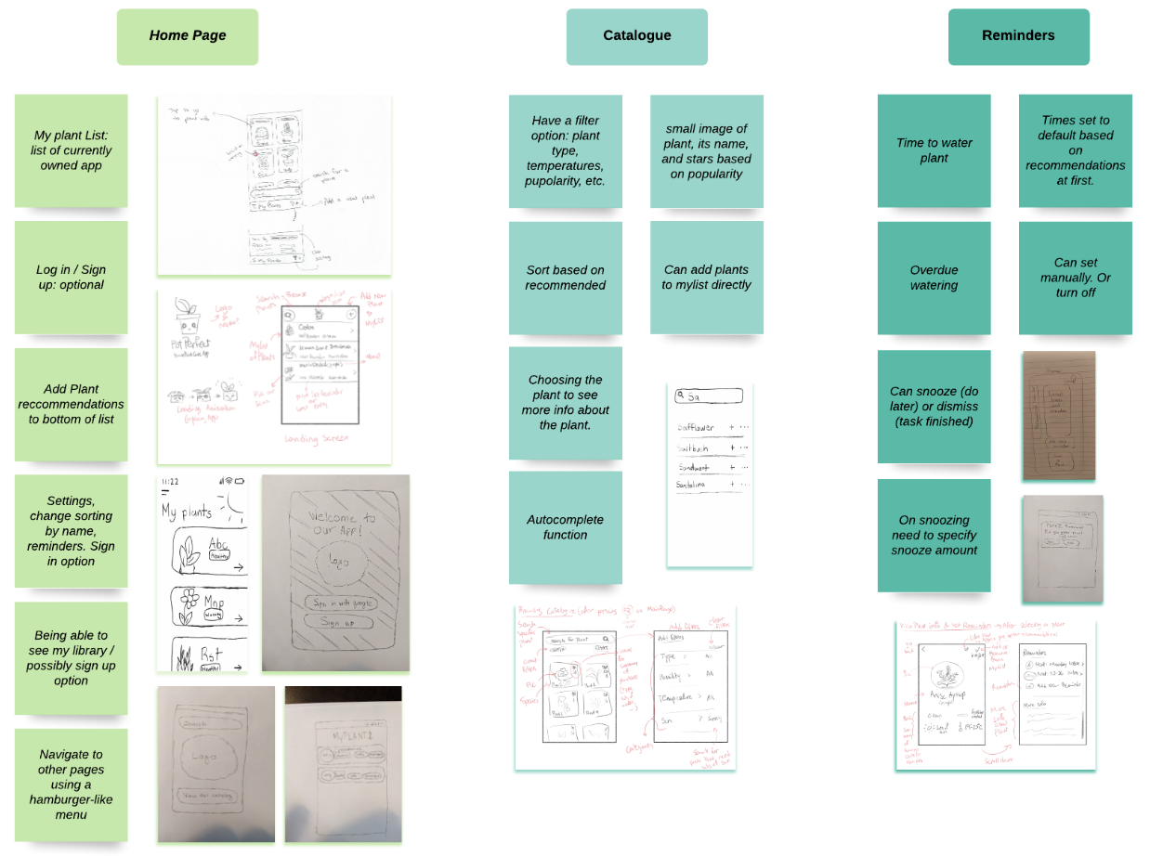
Affinity Diagram
Notes:
Jason
In our affinity diagram, we focused on 5 features of application
The first three presented on this slide are the home page, catalogue and reminders features.
The home page is the first screen that users will see when opening the app, and contains the list of plants that they currently own.
The catalogue contains entries with information for many other plants, including those that the users don’t own.
And the reminders feature helps plant owners ensure that their plants are taken care of when needed by sending owners with notifications.

Slide 4
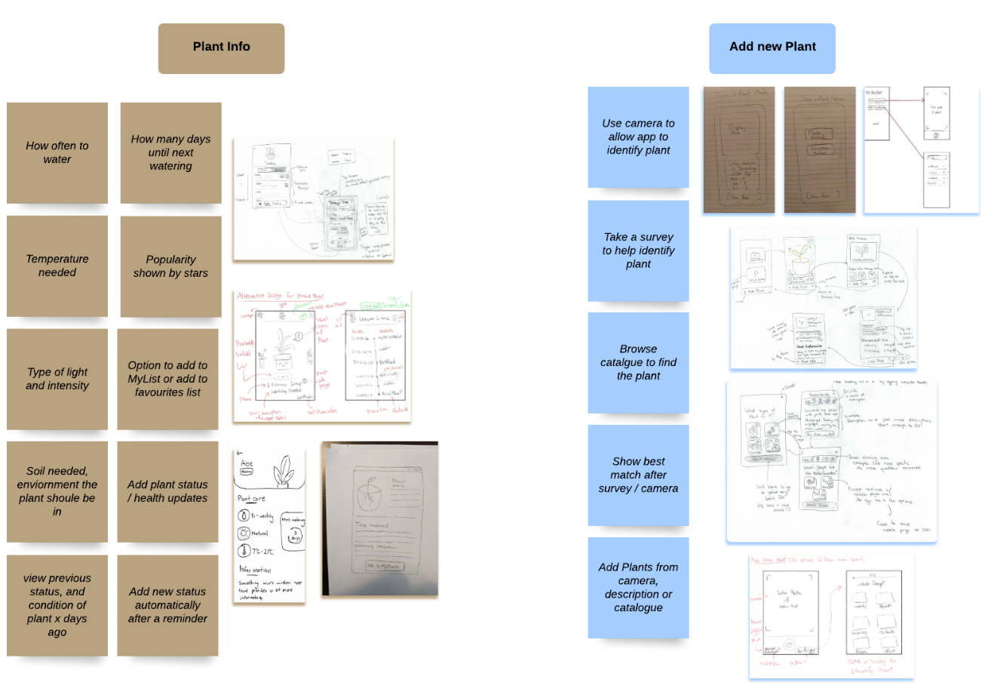
Affinity Diagram
Notes:
Jason
The final two features that were in out affinity diagram were the plant information and add new plants features.
The plant information screen provides users care taking information about a certain plant type, such as watering frequency and ideal temperatures.
Every type of plant will have a plant information screen that contains helpful information, regardless if the owner currently owns that specific plant.
And finally, the add new plant feature is how users would go about adding a new plant to their plant list. This can be done through either
The plant’s entry in the catalogue,
The camera,
Or a survey to identify the plant type.

Slide 5


Prototype Demo

Slide 6
Discarded Ideas
Favorite Plants Feature
Identifying plants with QR-codes
Navigation bar on the top or bottom
Notes:
Favorite Plants Feature:
We realized that we were adding this feature just for the sake of having this feature, and that there would be no real rhyme or reason for this feature to exist in our application.
Identifying plants with QR-codes:
This was the plan at first, but we realized it would be simpler and more intuitive if the application could identify the plant with just a photo of the plant.

Slide 7
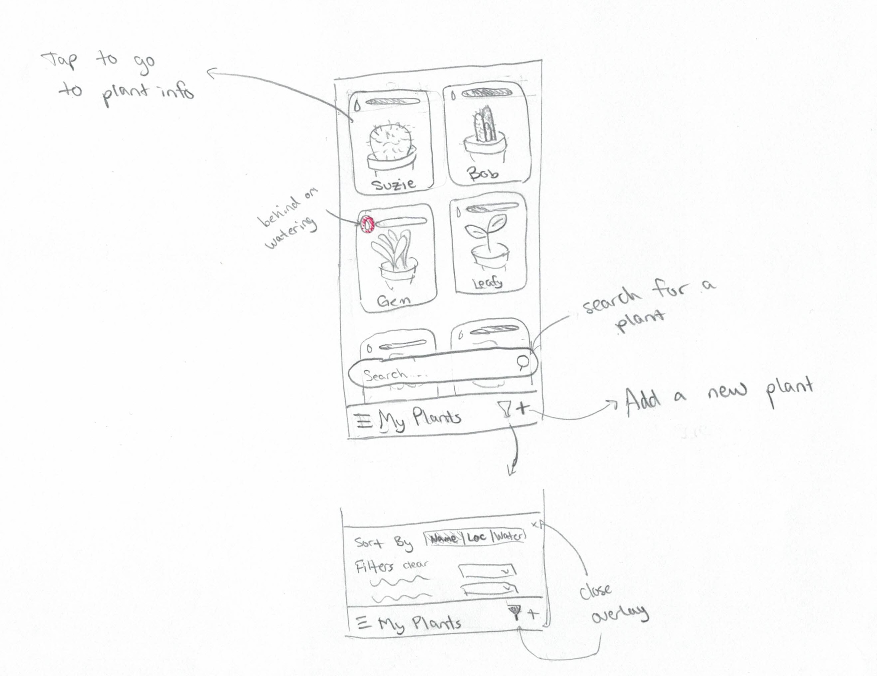
Refining the Project
Plant Information Screen
Narrowed down what information will be present on this screen
Decided on how this screen would be formatted, and where information would go
My Plant List / Home Screen
We had two list designs that we were debating on, eventually
decided on a layout like the following:
Notes:
Plant Information Screen
Narrowed down what information will be present on this screen
Decided on how this screen would be formatted, and where information would go
My Plant List / Home Screen
We had two list designs that we were debating on, eventually decided on a layout like the following:

Slide 8
Refining the Project
Navigation
Initially wanted to implement navigation bar
Chose to go with a menu for navigation to different features and screens
Recommended Plants
Initially located at the bottom of the catalogue
Now the recommended plants are shown at the opening of the home page
Notes:
Navigation
Initially wanted to implement navigation bar
Chose to go with a menu for navigation to different features and screens
Recommended Plants
Initially located at the bottom of the catalogue
Now the recommended plants are shown at the opening of the home page

Slide 9
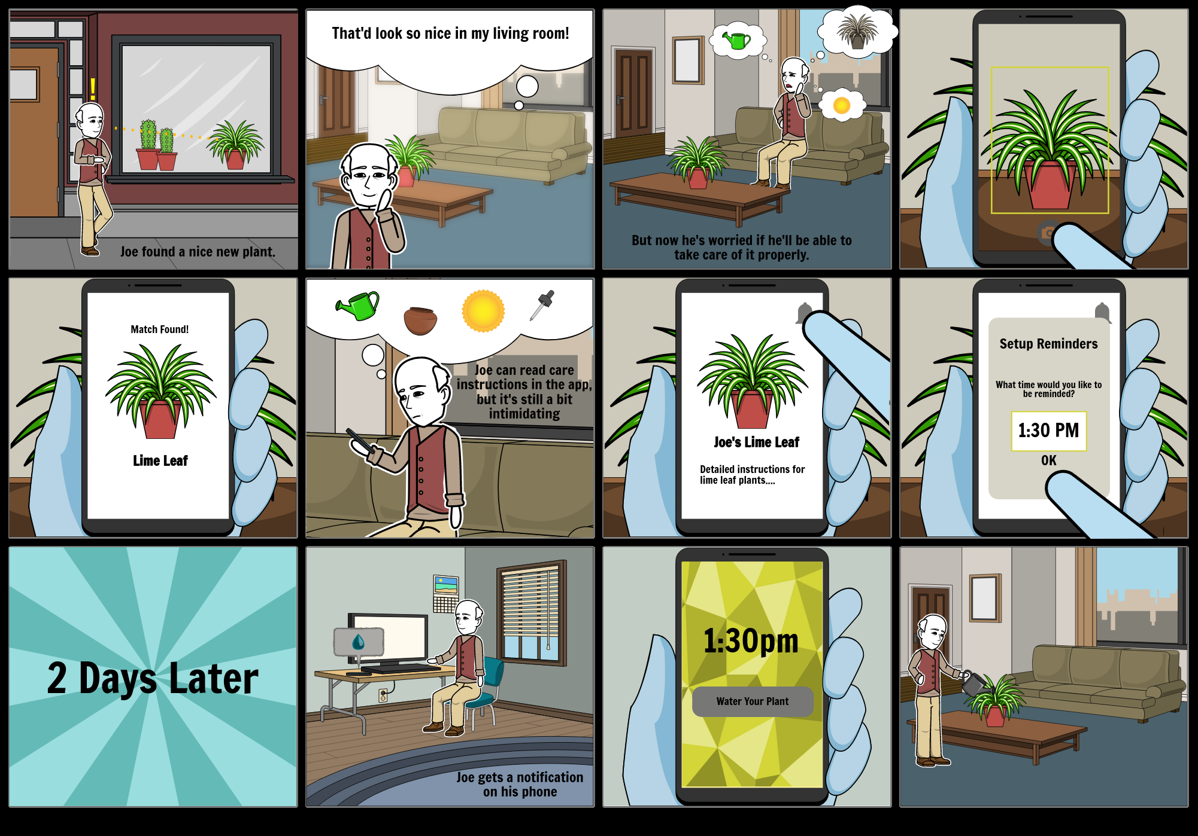
Storyboard
Notes:
After refining some ideas from the affinity diagram, we worked on a storyboard for the idea of setting up simple reminders based on default plant information. It tries to look at one of the big questions of the app: How can we simplify the process of learning how to care for a new plant?

Slide 10
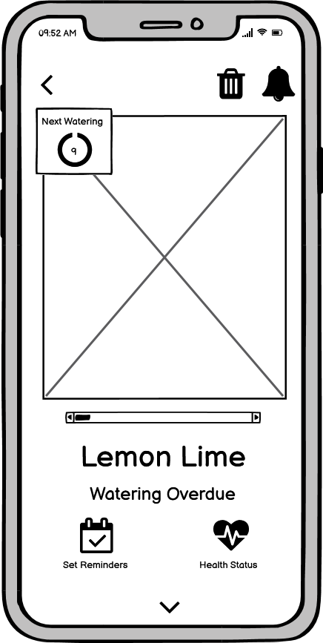
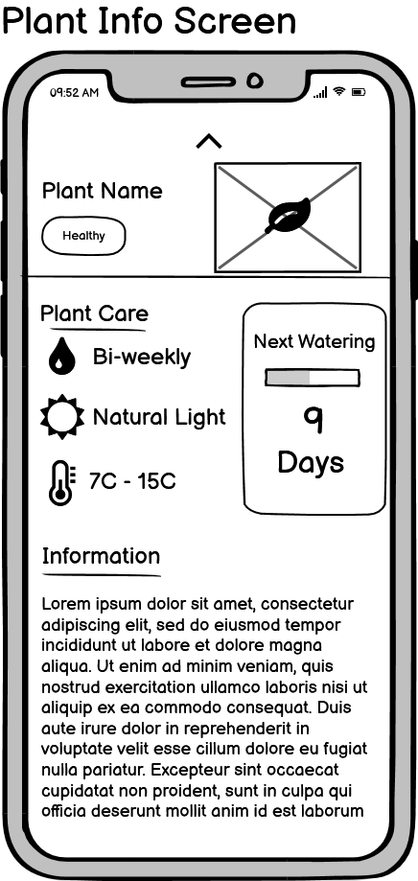
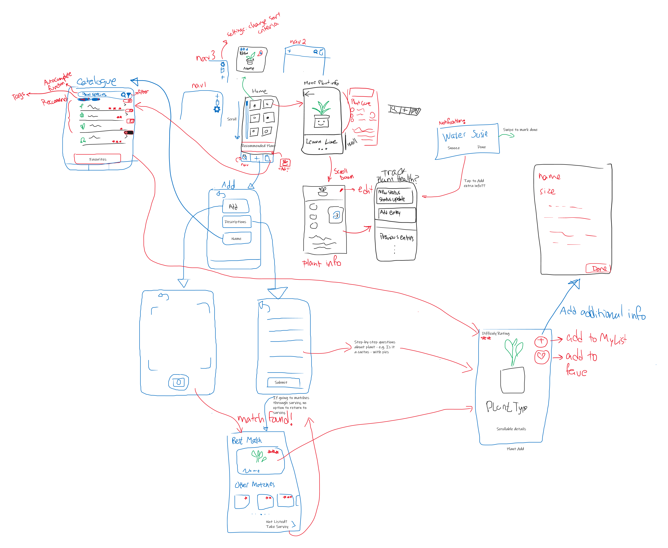
Lessons from Low-fi Designs
Scrollable interactions are hard to prototype
Notes:
Gabby

Slide 11
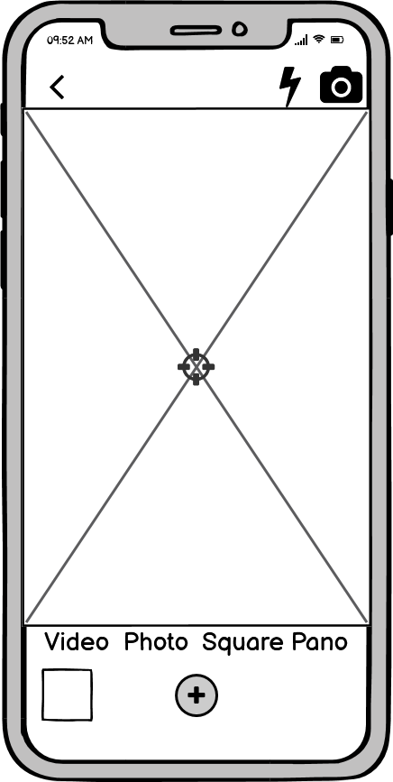
Lessons from Low-fi Designs
Scrollable interactions are hard to prototype
Quick to update/adjust
Helped solidify mental connections between pages
Helped to find UX flaws through interacting with low-fi prototype
Notes:
Gabby

Slide 12
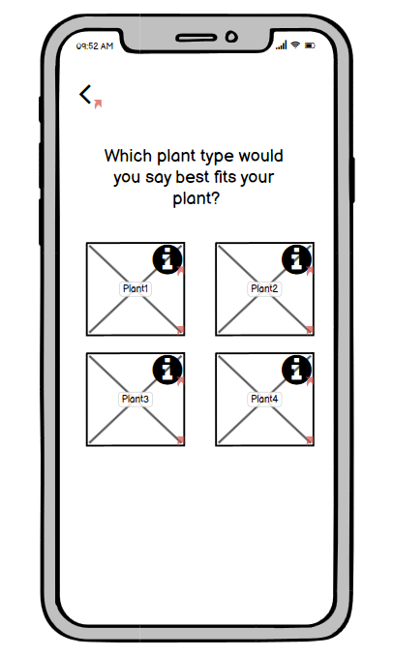
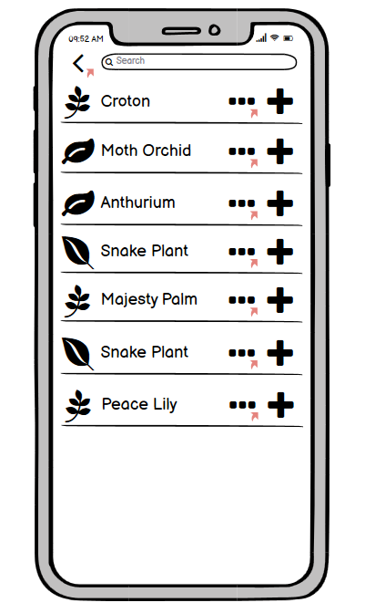

Cognitive Walkthrough
Conclusions:
Add optional guides for less intuitive features
Prioritize showcasing the major functions
Decrease ambiguity
Modifications:
Add back navigation
Add info boxes
Future Modifications:
Add User manual or guideline
Notes:
After finishing the first low-fi design draft, we used the given template to conduct a task-centred system cognitive walk through. We went through the user tasks that we laid out one by one and wrote down what could go wrong and what could be improved. Afterwards, we came to the following general conclusions: We could add optional guides or walk throughs especially for less intuitive areas, we should prioritize showcasing the more major functions over the minor ones. For example, viewing a plant information vs adding a plant status update. And finally do our best to decrease ambiguity. The modifications that we added to the prototype were: back navigation to almost all pages and information boxes on survey answers as well as some other unintuitive or ambiguous areas. In the future, that is for the high fidelity prototype or maybe even the final product, we decided that we could add a complete user manual or guideline.

Slide 13

Lessons we Learned
Identify Tasks that are more time-consuming and plant accordingly.
Through the process of refining our application, the result will change from what was originally envisioned.
Don't hesitate to seek help from TAs or the Instructor if unsure.
Notes:
There were quite a few tasks we had for this stage of our project so we decided to meet more often and stay organized to keep on track. We came prepared for every meeting with our ideation process done individually so we could discuss our ideas and bring them together during meetings. And I think we did pretty well given the timeframe. Some of the tasks given for this stage, for example the affinity diagram, weren’t fully explained before we completed them, so we had to retract our steps and revise what we had already done after they were expanded on. Going forward, I believe we should continue to hold frequent meetings with goals for each and tasks to do beforehand for every member. Furthermore, we should better identify which tasks will need more time and ask our instructor or TA for help whenever we’re unsure.

Slide 14
Thanks for Watching!
Notes:
Thanks for watching and have a lovely day!

